Slide 1
Comparing Pie charts

Slide 2
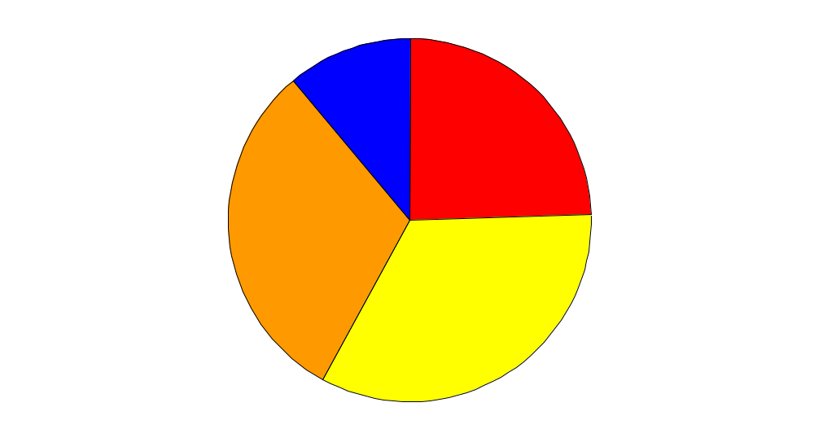
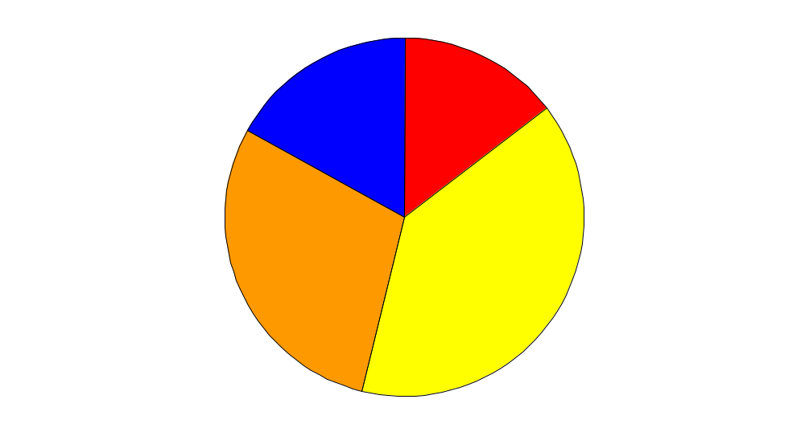
Age of people in Greece & Ireland
Ireland
Greece
Under 15
15-39
40-59
Over 59
Do the charts show that
a there are more people under 15 in Ireland than in Greece
b there are fewer people under 15 in Greece than in Ireland
c there is a higher proportion of people under 15 in Ireland
than in Greece?

